Slide 1
Statistical Analysis of Pitting Corrosion of Iron in CO₂ Saturated Brine with Phosphate Ester Inhibitor
Timothy Lee
University of California Berkeley
Dept. of Material Science and Engineering

Slide 2
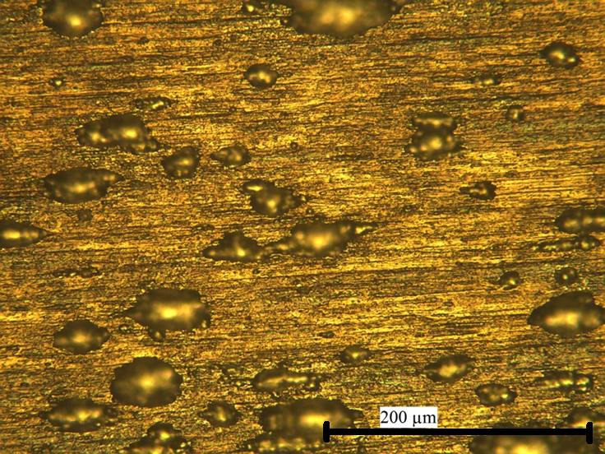
What is pitting corrosion?
Instead of uniform metal loss over the surface, corrosion now becomes confined to specific areas on the metal surface.
One of many pits

Slide 3
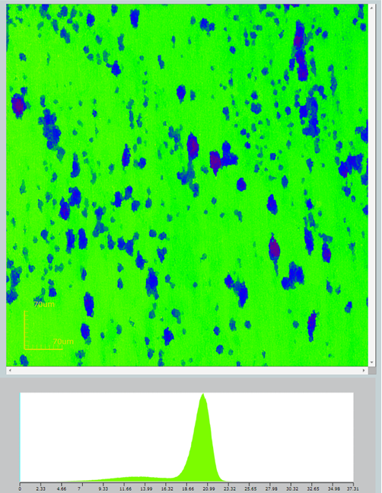
Contour Maps of Corroded Surfaces
A confocal microscope is used to create high resolution contour maps of corroded samples.
Colder colors are lower on the surface
A histogram of pixel heights is displayed at the bottom
Picture Dimensions: 640 µm x 640 µm

Slide 4
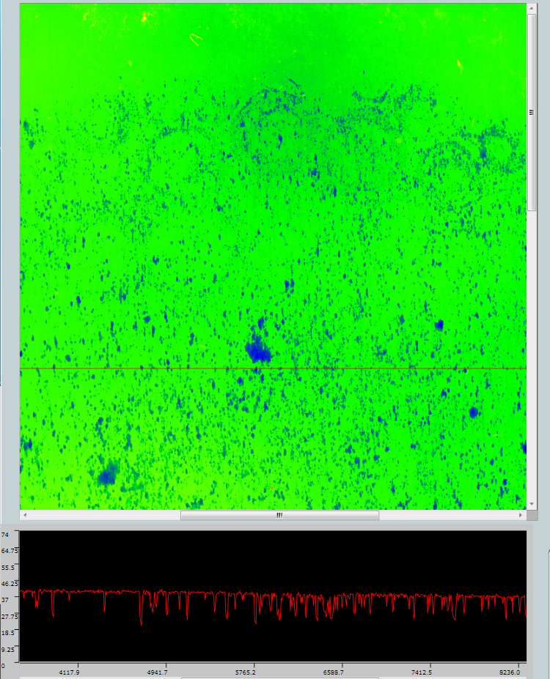
Contour Maps of Corroded Surfaces
Approximately 400 maps are taken per sample and stitched together

Slide 5
Reprocessing and Analyzing Data
Need robust metrics to define what a “pit” is from (x, y, z) data
Use a program to plot distributions of pit depths, pit mouth areas, and pit aspect ratios (depth vs. width)

Slide 6
Assumptions Made
Histogram of all of the heights of the pixels is displayed at the bottom
Surface roughness of the uncorroded region results in a normal distribution
Left skewness is due to pitting corrosion
Left tail due to pitting corrosion. Where do we set the boundary to separate pitting corrosion pixels from surface roughness pixels?
Pixels from uncorroded regions. Standard deviation indicates the surface roughness of the sample.

Slide 7
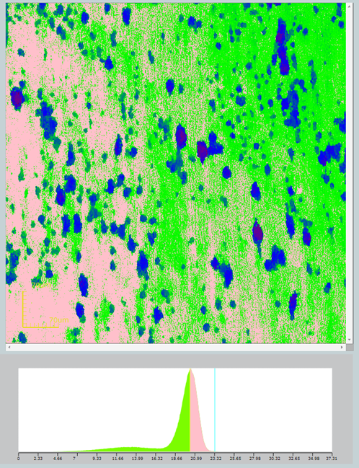
Obtaining the Lower Bound
Assume that pixels that are two standard deviations below the median of the surface are not due to surface roughness
Export pixel values
Calculate 2σ by finding the 97.5 percentile of the upper half of the normal distribution
2σ above the mean. Pixels between the median and 2σ are pink

Slide 8
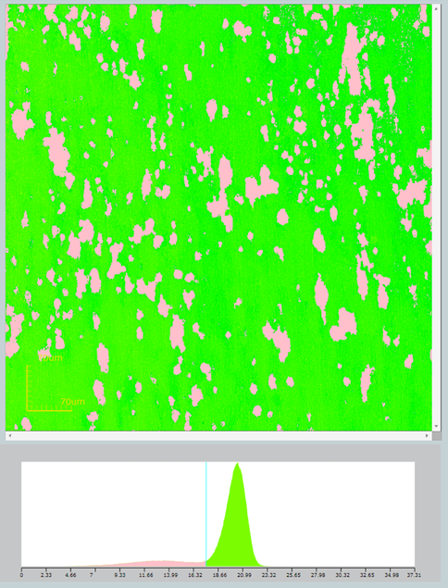
Find clusters of pixels to form pits
Select all the pixels below the lower bound
Use object detection software to detect pixels clusters with a connectivity of 4
Software provides information on detected pit depths and areas
Pixels lower than 2σ below the mean are pink.

Slide 9
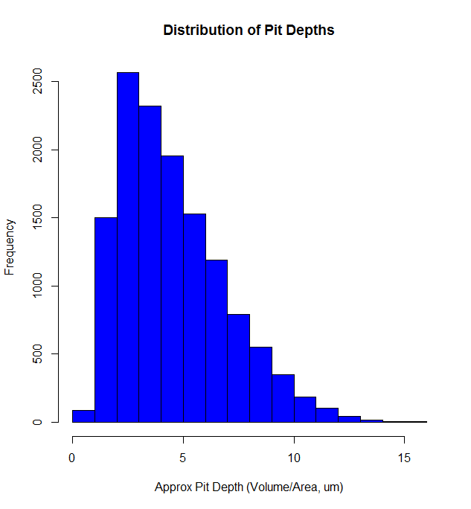
Histogram of Average Pit Depths
Pit Depth Approximated as: Pit Volume/Pit Mouth Area
Skewed Right: Many shallow pits, few deep pits

Slide 10
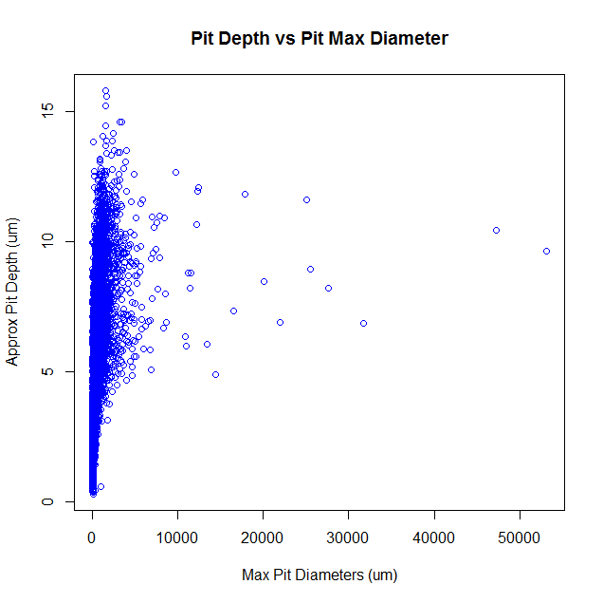
Plot of Pit Depth vs. Pit Diameters
The majority of pits have high depth/diameter ratios. Typical for pitting corrosion.
Quite a few of the large pits of very low depth/diameter ratios. This is HIGHLY unusual for pitting corrosion.

Slide 11
Takeaway Points
Created a set of robust criteria that is used to define a pit
Many of the large pits have very low depth/diameter aspect ratios
This characteristic is atypical of normal pitting corrosion
This observation prompted further scientific investigations into the mechanism of pitting corrosion for these large pits

